Slide 1

April 2018
Notes:
Welcome to the meetup etc, hands up who is a developer, etc.

Slide 2
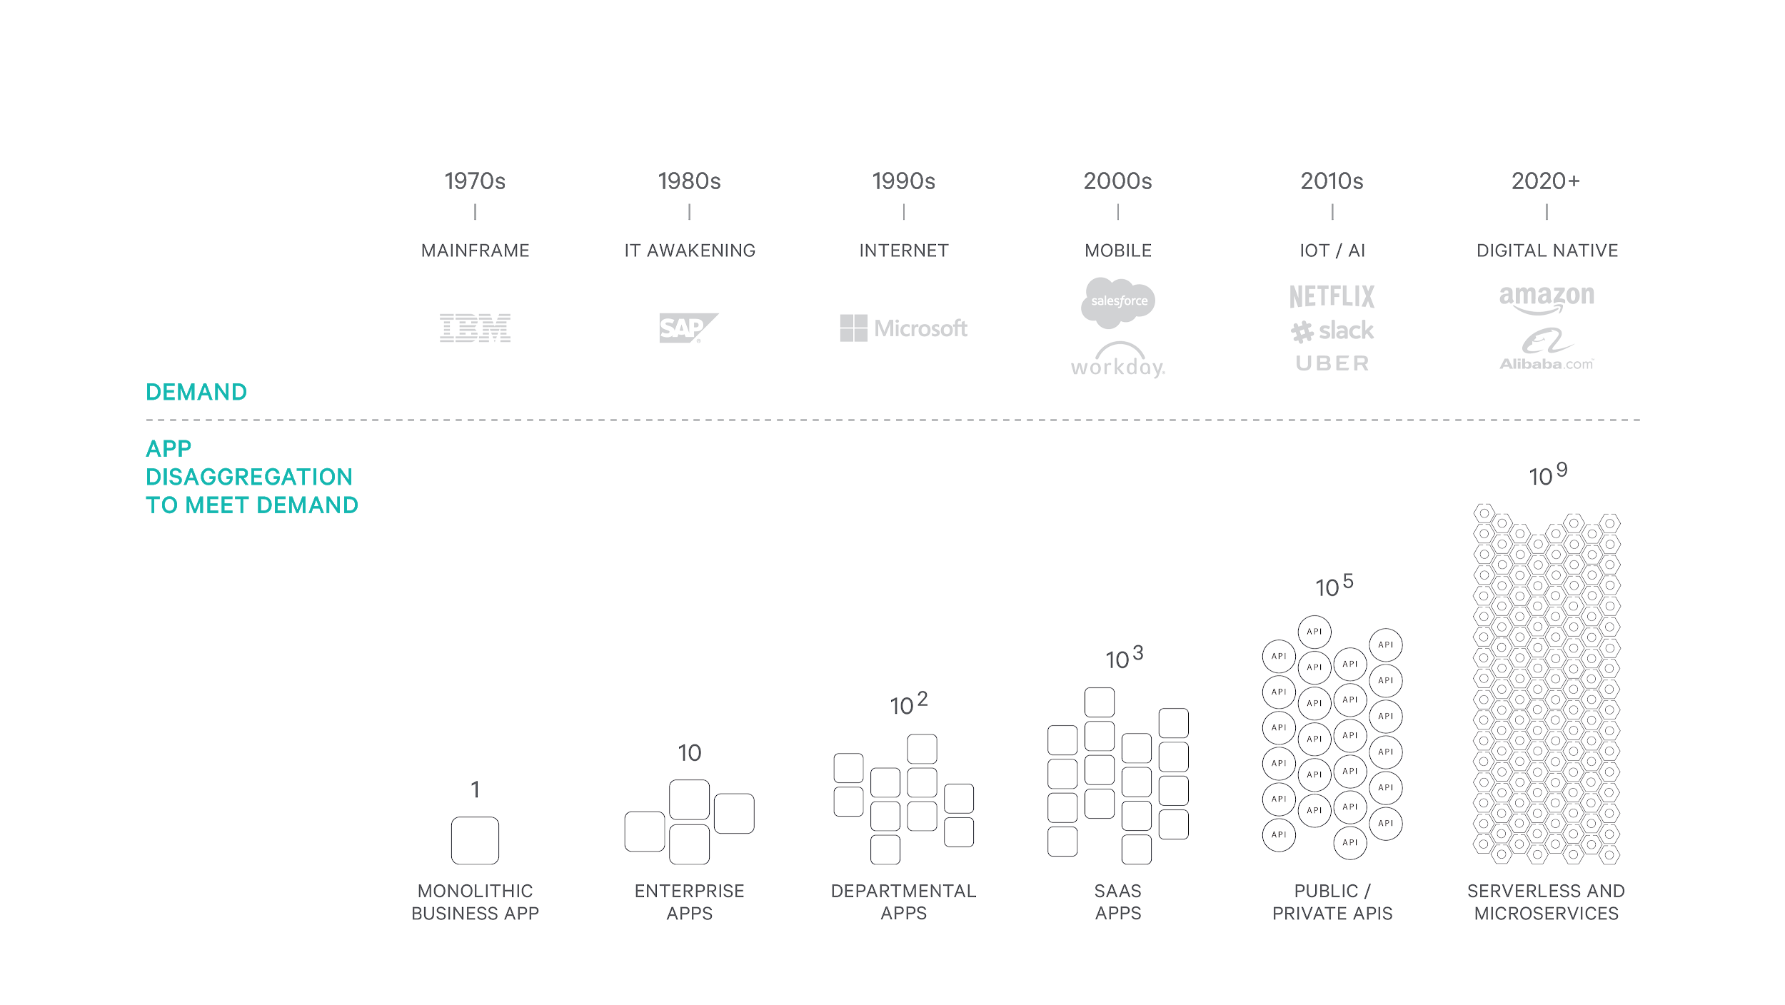

Increasing demand is causing disaggregation
Notes:
Crazy customer demand has led to the rise of companies like Google, Uber, and Amazon. They have had to build complex systems to meet customer demand. If you look at how those companies have evolved, they have increasingly disaggregated their architectures in order to scale.
This is a continuation of a trend that we have seen over five decades. Massively disaggregated approaches like microservices, serverless, and APIs are becoming the norm for us all.

Slide 3
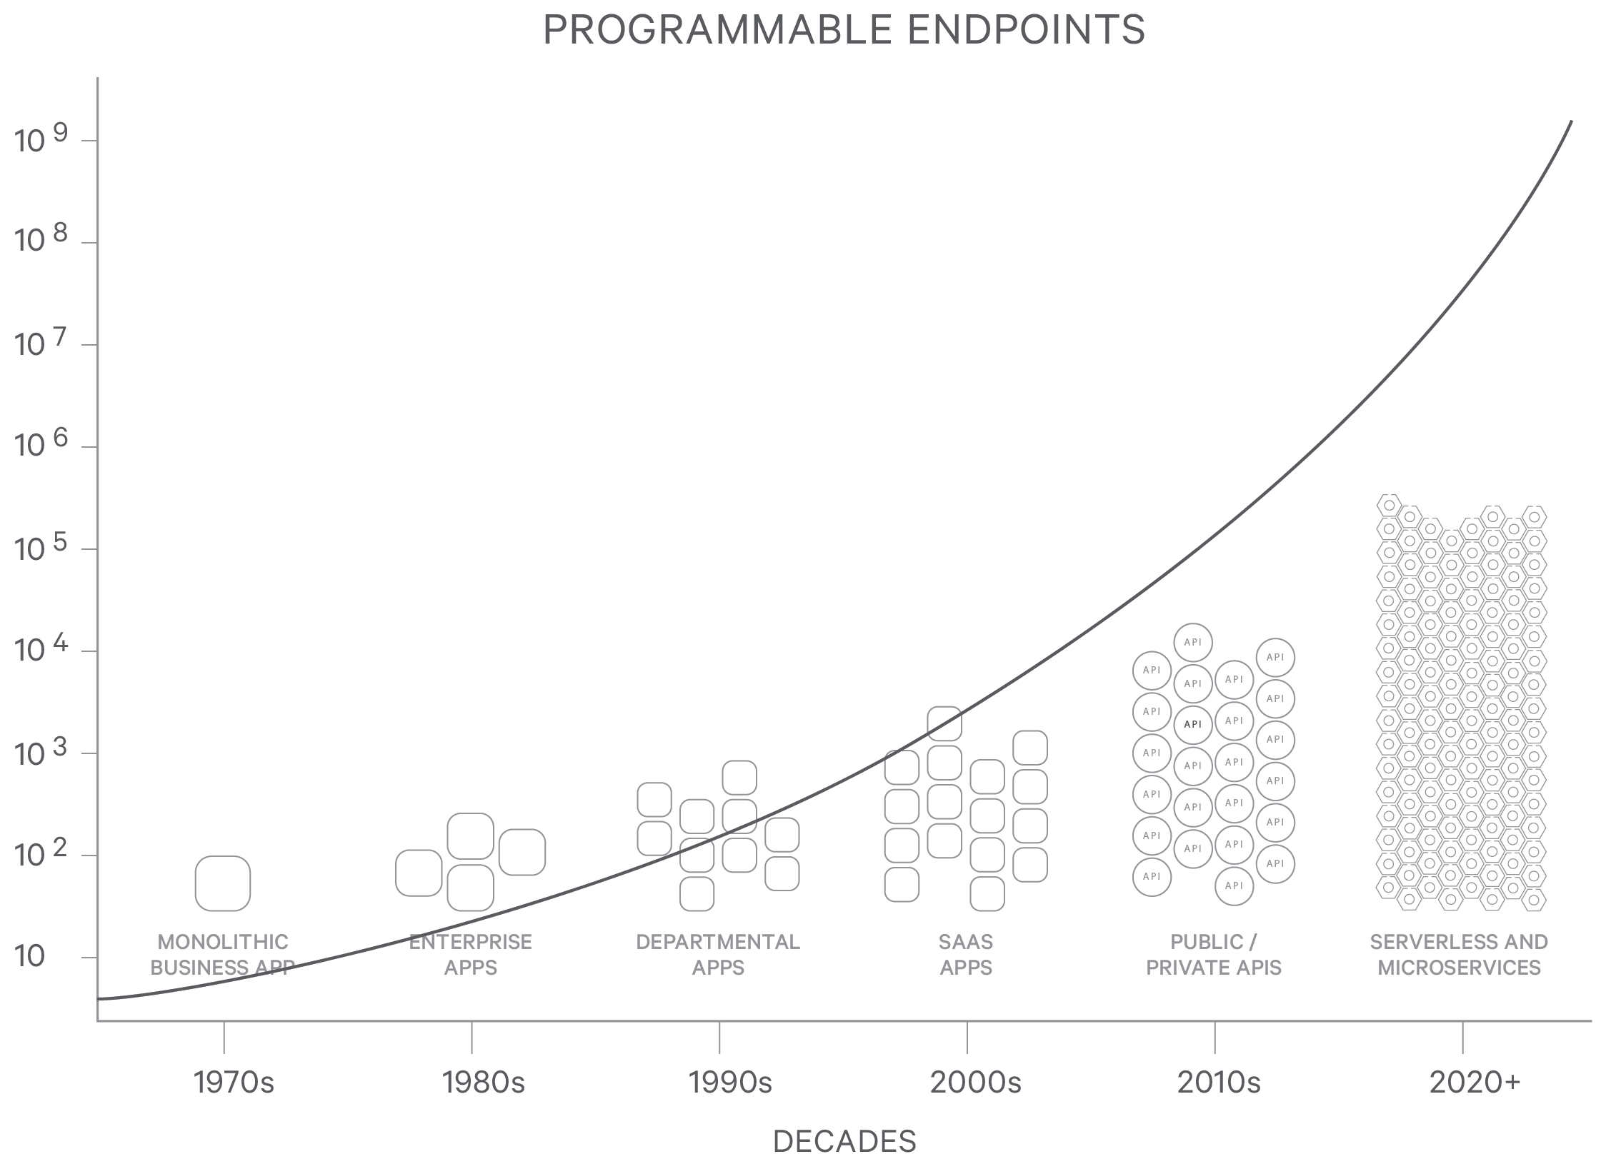

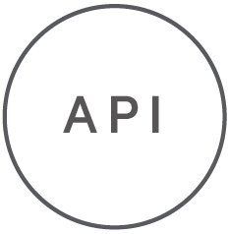




Disaggregation leads to more endpoints
Everything is An Endpoint
Functions
APIs
Data
SaaS apps
Legacy apps
Devices
Notes:
We have seen these disaggregated components become network accessible. We call them endpoints. Whether it is data, apps, APIs, microservices, or serverless functions, everything is becoming a programmable endpoint. The number of endpoints is exploding.

Slide 4
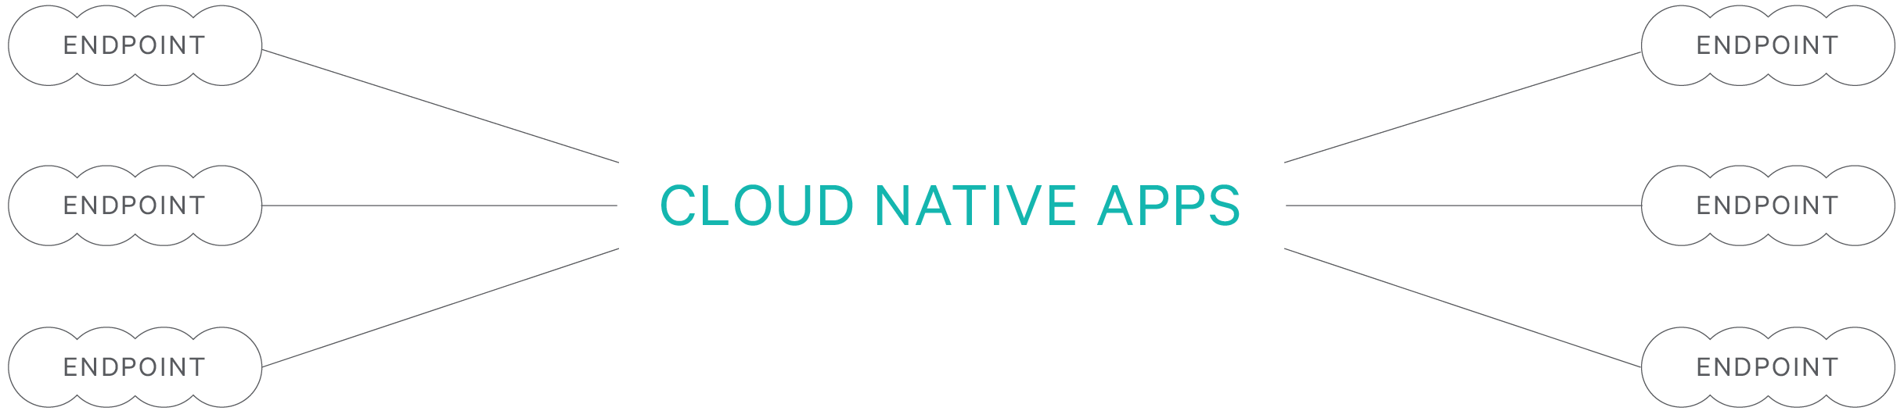
Integration in an increasingly disaggregated world
Transactions
Circuit Breaking
Protocols
Payloads
Events
Security
Workflow
Streams
Compensation
Notes:
The apps we will write increasingly depend on these endpoints. Integration is the discipline of resilient communication between endpoints. It isn’t easy. The challenges include compensation, transactions, events, circuit breakers, discovery, and protocol handling, and mediation. These are all hard problems.

Slide 5



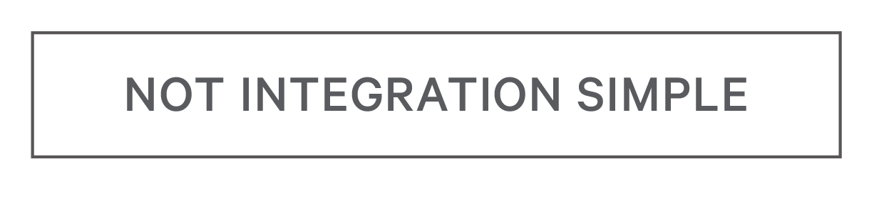
The
Integration
Gap
ESB, BPMN, EAI
Java / Spring JavaScript / Node
Notes:
Slide 4 part 1 (ESBs etc on the left)
There have been two ways to handle integration.
One approach to scale integration has used integration products based on configuration, not code. We’ve created EAI, ESBs, and DSLs as integration-first stacks.
Slide 4 part 2 (box them with “not agile”)
There’s only one problem. These approaches aren’t agile. They disrupt the edit, build, run, test cycle interrupting a developer’s flow. And that isn’t the experience we desire as developers.
Slide 4 part 3 (add the agile technologies)
The other way to do integration is with general purpose programming languages, like Java and JavaScript. These languages provide agility to offer developer flow.
Slide 4 part 4 (box agile with “not integration simple”)
However, developers have to take responsibility for solving the hard problems of integration. They do this by writing their own integration logic or by using complex bolt-on frameworks like Spring or Node. This approach is agile, but not integration simple.
Slide 4 part 5 (integration gap)
This is a fundamental problem - you can have integration simple or agile, but not both.
We call this the integration gap.
Our team has worked on thousands of integration projects. We’ve seen and used almost every integration technique out there. Those projects have always ended up on one side or the other of the integration gap.

Slide 6
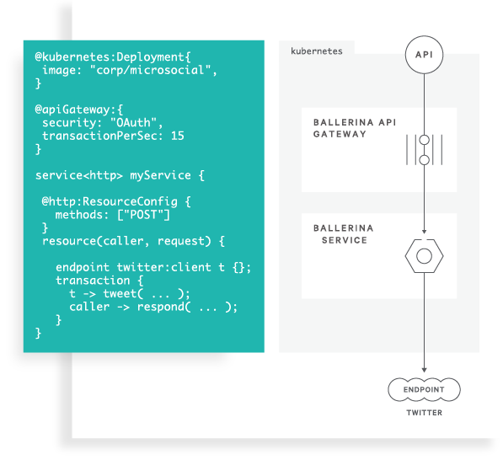
AGILE
INTEGRATION SIMPLE
Notes:
Three years ago, we set out to overcome this problem. The result is Ballerina. Ballerina is a programming language and a platform co-designed together to create an approach that is both agile and integration simple.
Let’s see some demos.

Slide 7
Ballerina is a compiled, type safe, Turing-complete, concurrent
programming language.

Slide 8
Hello World
Notes:
// The simplest hello world REST API
// To run it:
// ballerina run demo.bal
// To invoke:
// curl localhost:9090/hello/hi
import ballerina/http;
service<http:Service> hello bind {port:9090} {
hi (endpoint caller, http:Request request) {
http:Response res;
res.setTextPayload("Hello World!\n");
_ = caller->respond(res);
}
}

Slide 9

caller
hello
GET
Hello World
Notes:
// The simplest hello world REST API
// To run it:
// ballerina run demo.bal
// To invoke:
// curl localhost:9090/hello/hi
import ballerina/http;
service<http:Service> hello bind {port:9090} {
hi (endpoint caller, http:Request request) {
http:Response res;
res.setTextPayload("Hello World!\n");
_ = caller->respond(res);
}
}

Slide 10
Annotations
Notes:
// Add annotations for @ServiceConfig & @ResourceConfig
// to provide custom path and limit to POST
// Get payload from the POST request
// To run it:
// ballerina run demo.bal
// To invoke:
// curl -X POST -d "Demo" localhost:9090
import ballerina/http;
@http:ServiceConfig {
basePath: "/"
}
service<http:Service> hello bind {port:9090} {
@http:ResourceConfig {
path: "/",
methods: ["POST"]
}
hi (endpoint caller, http:Request request) {
string name = check request.getTextPayload();
http:Response res;
res.setTextPayload("Hello "+name+"!\n");
_ = caller->respond(res);
}
}

Slide 11
caller
hello
POST (name)
Hello, name!
Notes:
// Add annotations for @ServiceConfig & @ResourceConfig
// to provide custom path and limit to POST
// Get payload from the POST request
// To run it:
// ballerina run demo.bal
// To invoke:
// curl -X POST -d "Demo" localhost:9090
import ballerina/http;
@http:ServiceConfig {
basePath: "/"
}
service<http:Service> hello bind {port:9090} {
@http:ResourceConfig {
path: "/",
methods: ["POST"]
}
hi (endpoint caller, http:Request request) {
string name = check request.getTextPayload();
http:Response res;
res.setTextPayload("Hello "+name+"!\n");
_ = caller->respond(res);
}
}

Slide 12
Connectors

Slide 13
caller
hello
twitter
POST (status)
tweet (status)
response
response
Notes:
// Add twitter connector: import, create endpoint,
// create a new resource that invoke it
// To find it:
// ballerina search twitter
// To get it for tab completion:
// ballerina pull wso2/twitter
// To run it:
// ballerina run demo.bal --config twitter.toml
// To invoke:
// curl -X POST -d "Demo" localhost:9090
import ballerina/http;
import wso2/twitter;
import ballerina/config;
endpoint twitter:Client twitter {
clientId: config:getAsString("clientId"),
clientSecret: config:getAsString("clientSecret"),
accessToken: config:getAsString("accessToken"),
accessTokenSecret: config:getAsString("accessTokenSecret"),
clientConfig: {}
};
@http:ServiceConfig {
basePath: "/"
}
service<http:Service> hello bind {port:9090} {
@http:ResourceConfig {
path: "/",
methods: ["POST"]
}
hi (endpoint caller, http:Request request) {
http:Response res;
string status = check request.getTextPayload();
twitter:Status st = check twitter->tweet(status);
res.setTextPayload("Tweeted: " + status);
_ = caller->respond(res);
}
}

Slide 14
caller
hello
twitter
POST (status)
transform
tweet (status)
response
transform
response
Notes:
// Add transformation: #ballerina to input, and JSON to output
// To run it:
// ballerina run demo.bal --config twitter.toml
// To invoke:
// curl -X POST -d "Demo" localhost:9090
import ballerina/http;
import wso2/twitter;
import ballerina/config;
endpoint twitter:Client twitter {
clientId: config:getAsString("clientId"),
clientSecret: config:getAsString("clientSecret"),
accessToken: config:getAsString("accessToken"),
accessTokenSecret: config:getAsString("accessTokenSecret"),
clientConfig:{}
};
@http:ServiceConfig {
basePath: "/"
}
service<http:Service> hello bind {port:9090} {
@http:ResourceConfig {
path: "/",
methods: ["POST"]
}
hi (endpoint caller, http:Request request) {
http:Response res;
string status = check request.getTextPayload();
if (!status.contains("#ballerina")){status=status+" #ballerina";}
twitter:Status st = check twitter->tweet(status);
json myJson = {
text: status,
id: st.id,
agent: "ballerina"
};
res.setJsonPayload(myJson);
_ = caller->respond(res);
}
}

Slide 15
Docker & Kubernetes
Notes:
// Add kubernetes package and annotations
// To build kubernetes artifacts:
// ballerina build demo.bal
// To run it:
// kubectl apply -f kubernetes/
// To see the pod:
// kubectl get pods
// To see the service:
// kubectl get svc
// To invoke:
// curl -X POST -d "Hello from K8S" localhost:<put the port that you get from kubectl get svc>
// To clean up:
// kubectl delete -f kubernetes/
import ballerina/http;
import wso2/twitter;
import ballerina/config;
import ballerinax/kubernetes;
endpoint twitter:Client twitter {
clientId: config:getAsString("clientId"),
clientSecret: config:getAsString("clientSecret"),
accessToken: config:getAsString("accessToken"),
accessTokenSecret: config:getAsString("accessTokenSecret"),
clientConfig:{}
};
@kubernetes:Service {
serviceType: "NodePort",
name: "ballerina-demo"
}
endpoint http:Listener listener {
port: 9090
};
@kubernetes:Deployment {
image: "demo/ballerina-demo",
name: "ballerina-demo"
}
@kubernetes:ConfigMap{
ballerinaConf: "twitter.toml"
}
@http:ServiceConfig {
basePath: "/"
}
service<http:Service> hello bind listener {
@http:ResourceConfig {
path: "/",
methods: ["POST"]
}
hi (endpoint caller, http:Request request) {
http:Response res;
string status = check request.getTextPayload();
if (!status.contains("#ballerina")){status=status+" #ballerina";}
twitter:Status st = check twitter->tweet(status);
json myJson = {
text: status,
id: st.id,
agent: "ballerina"
};
res.setJsonPayload(myJson);
_ = caller->respond(res);
}
}

Slide 16
Observability
Notes:
Talk to the screenshots in the next few slides

Slide 17
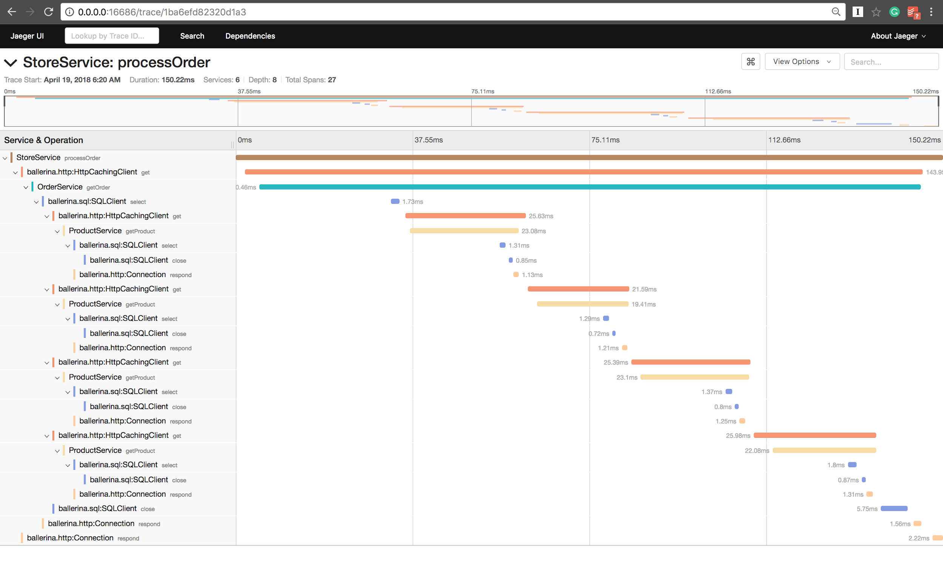
Jaeger

Slide 18
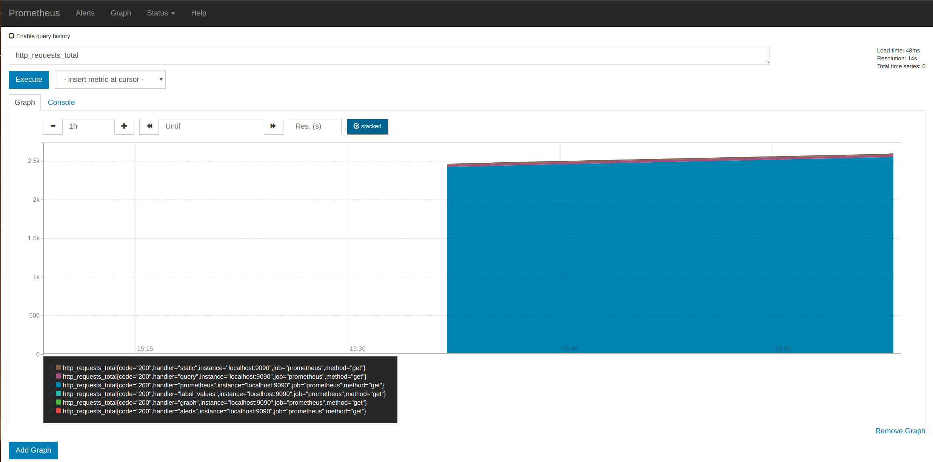
Prometheus

Slide 19
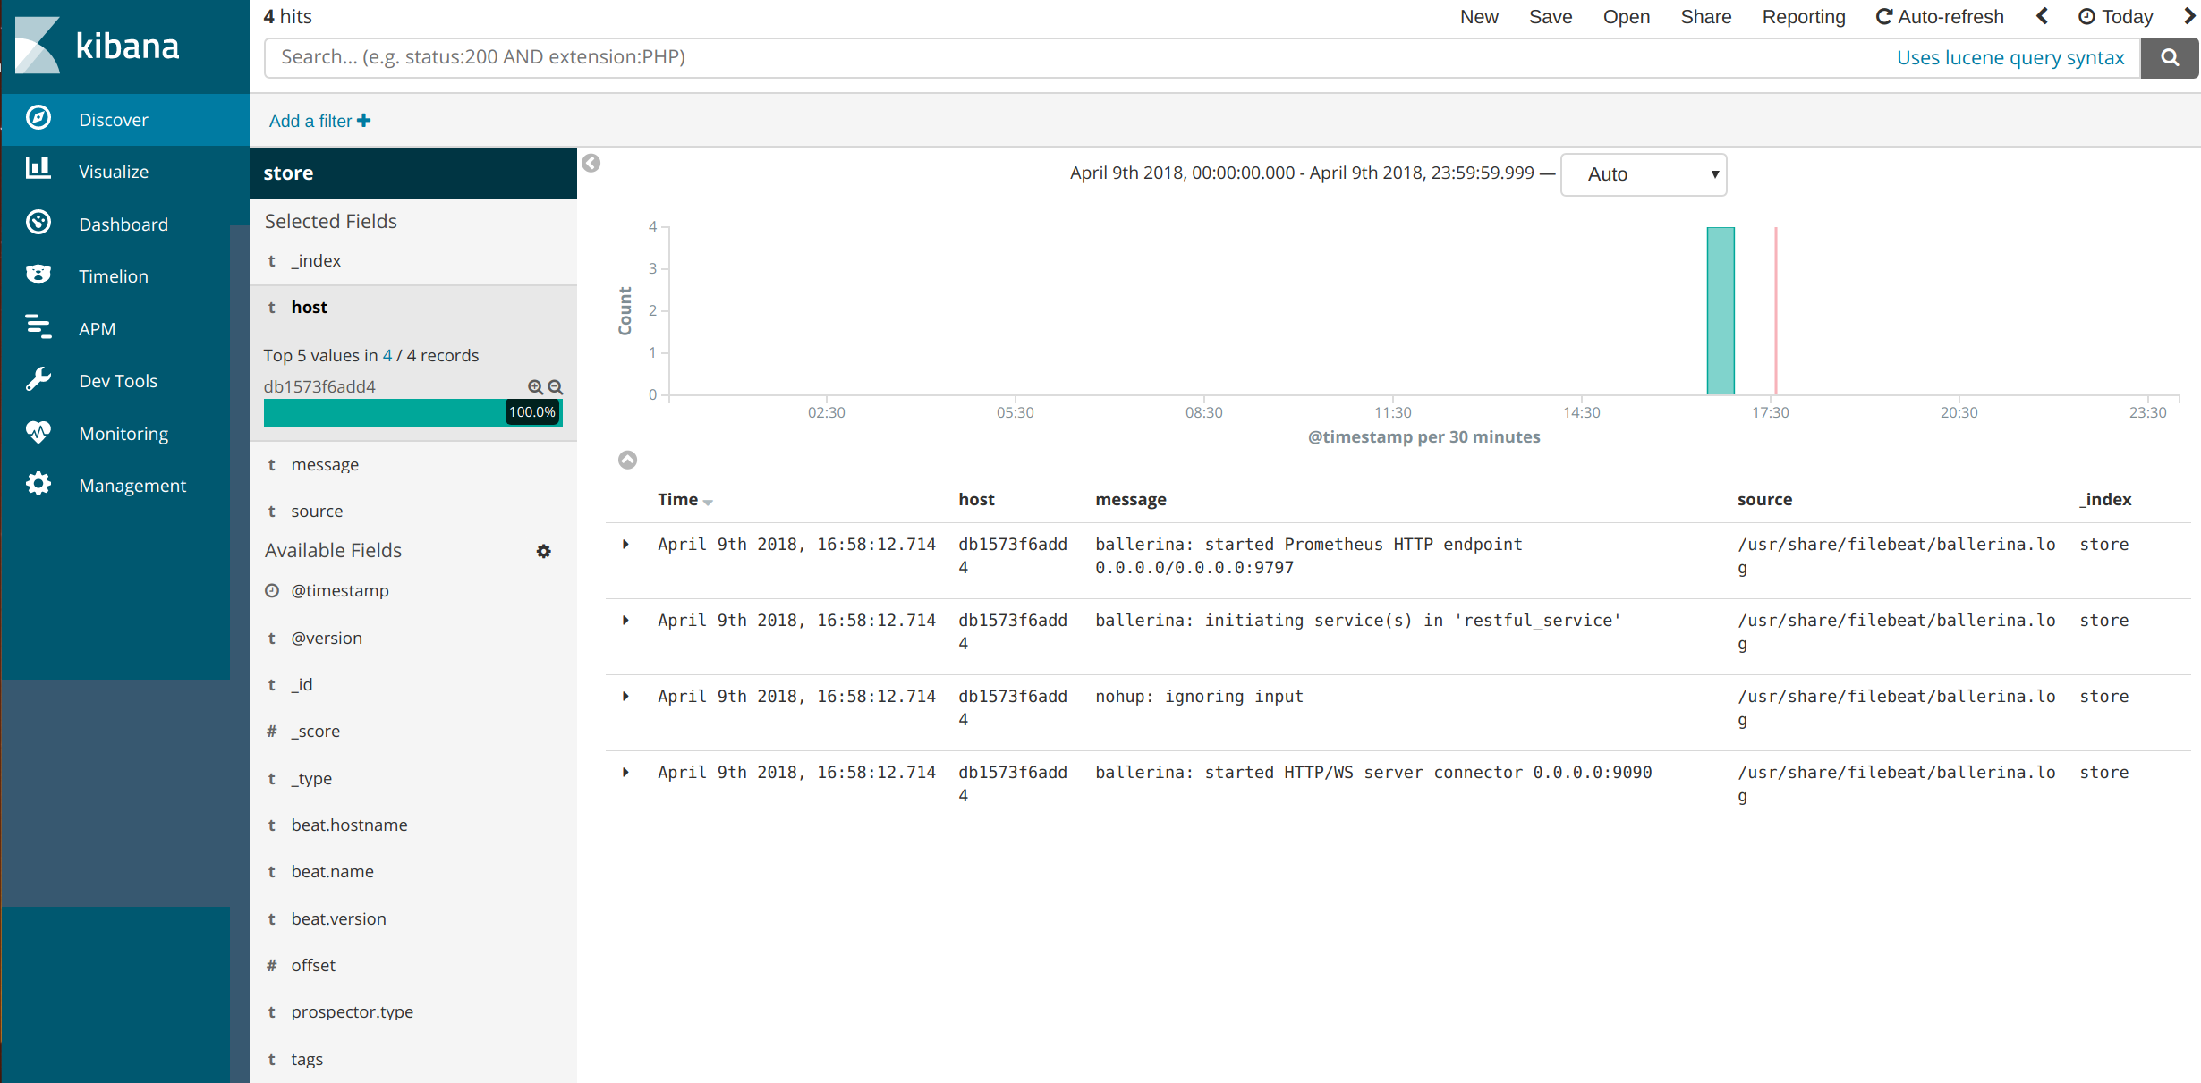
ElasticSearch / Kibana / Logstash (ELK)

Slide 20
Circuit Breaker
Notes:
Back to the demo. For simplicity, we will just use local execution – w/o K8S for the rest of the demo.

Slide 21
caller
hello
Simpson quotes
twitter
GET
quote
tweet (quote)
response
response
Notes:
// Add another external web service endpoint
// to compensate for slowness use circuit breaker
// To run it:
// ballerina run demo.bal --config twitter.toml
// To invoke:
// curl -X POST localhost:9090
// Invoke a few times to show that it is often slow
import ballerina/http;
import wso2/twitter;
import ballerina/config;
endpoint http:Client homer {
url: "http://www.simpsonquotes.xyz"
};
endpoint twitter:Client twitter {
clientId: config:getAsString("clientId"),
clientSecret: config:getAsString("clientSecret"),
accessToken: config:getAsString("accessToken"),
accessTokenSecret: config:getAsString("accessTokenSecret"),
clientConfig: {}
};
@http:ServiceConfig {
basePath: "/"
}
service<http:Service> hello bind {port:9090} {
@http:ResourceConfig {
path: "/",
methods: ["POST"]
}
hi (endpoint caller, http:Request request) {
http:Response res;
http:Response hResp = check homer->get("/quote");
string status = check hResp.getTextPayload();
if (!status.contains("#ballerina")){status=status+" #ballerina";}
twitter:Status st = check twitter->tweet(status);
json myJson = {
text: status,
id: st.id,
agent: "ballerina"
};
res.setJsonPayload(myJson);
_ = caller->respond(res);
}
}

Slide 22
caller
hello
Simpson quotes
twitter
Open
Circuit Breaker logic
tweet
response
response
Notes:
// To compensate for slowness use circuit breaker
// To run it:
// ballerina run demo_circuitbreaker.bal --config twitter.toml
// To invoke:
// curl -X POST localhost:9090
// Invoke many times to show how circuit breaker works
import ballerina/http;
import wso2/twitter;
import ballerina/config;
endpoint http:Client homer {
url: "http://www.simpsonquotes.xyz",
circuitBreaker: {
failureThreshold: 0,
resetTimeMillis: 3000,
statusCodes: [500, 501, 502]
},
timeoutMillis: 500
};
endpoint twitter:Client twitter {
clientId: config:getAsString("clientId"),
clientSecret: config:getAsString("clientSecret"),
accessToken: config:getAsString("accessToken"),
accessTokenSecret: config:getAsString("accessTokenSecret"),
clientConfig: {}
};
@http:ServiceConfig {
basePath: "/"
}
service<http:Service> hello bind {port: 9090} {
@http:ResourceConfig {
path: "/",
methods: ["POST"]
}
hi (endpoint caller, http:Request request) {
http:Response res;
var v = homer->get("/quote");
match v {
http:Response hResp => {
string status = check hResp.getTextPayload();
if (!status.contains("#ballerina")){status=status+" #ballerina";}
twitter:Status st = check twitter->tweet(status);
json myJson = {
text: status,
id: st.id,
agent: "ballerina"
};
res.setJsonPayload(myJson);
}
error err => {
res.setTextPayload("Circuit is open. Invoking default behavior.\n");
}
}
_ = caller->respond(res);
}
}

Slide 23
Asynchronous
Notes:
// Move all the invocation and tweeting functionality to another function
// call it asynchronously
// To run it:
// ballerina run demo_async.bal --config twitter.toml
// To invoke:
// curl -X POST localhost:9090
// Invoke many times to show how quickly the function returns
// then go to the browser and refresh a few times to see how gradually new tweets appear
import ballerina/http;
import wso2/twitter;
import ballerina/config;
endpoint twitter:Client twitter {
clientId: config:getAsString("clientId"),
clientSecret: config:getAsString("clientSecret"),
accessToken: config:getAsString("accessToken"),
accessTokenSecret: config:getAsString("accessTokenSecret"),
clientConfig: {}
};
endpoint http:Client homer {
url: "http://www.simpsonquotes.xyz"
};
@http:ServiceConfig {
basePath: "/"
}
service<http:Service> hello bind {port: 9090} {
@http:ResourceConfig {
path: "/",
methods: ["POST"]
}
hi (endpoint caller, http:Request request) {
var v = start doTweet();
http:Response res;
res.setTextPayload("Async call\n");
_ = caller->respond(res);
}
}
function doTweet() {
http:Response hResp = check homer->get("/quote");
string status = check hResp.getTextPayload();
if (!status.contains("#ballerina")){ status = status+" #ballerina"; }
_ = twitter->tweet(status);
}

Slide 24
Swagger
Notes:
ballerina swagger export demo.bal

Slide 25
Sequence Diagrammatic
Notes:
Just toggle the diagram view inside the IDE

Slide 26
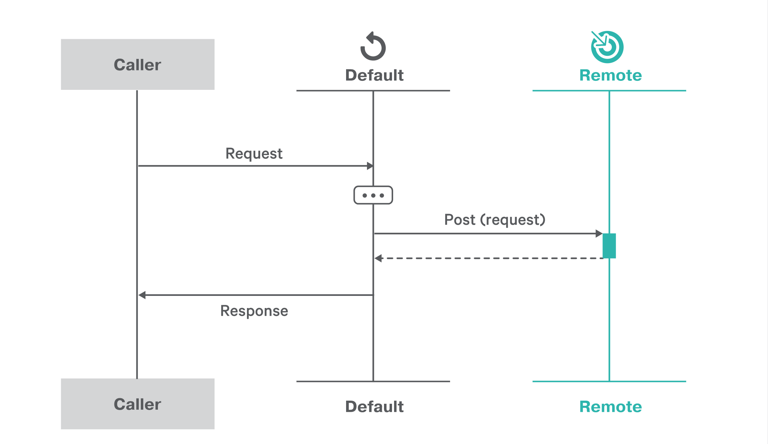

Slide 27
Versus Spring

Slide 28
// Spring Integration - NOT INTEGRATION SIMPLE
@Component public class PersonEndpoint { @Autowired private PersonService service; public Message<?> get(Message<String> msg) { return MessageBuilder.fromMessage(msg) .copyHeadersIfAbsent(msg.getHeaders()) .setHeader(STATUSCODE_HEADER, HttpStatus.NOT_FOUND) .build(); }
// + 20 more lines of Java
// + XML config for routing and mediation logic <beans:beans> <channel id="inputChannel"/> <channel id="outputChannel"> <queue capacity="10"/> </channel> <service-activator input-channel="inputChannel" output-channel="outputChannel" ref="helloService" method="sayHello"/>
<beans:bean id="helloService" class="samples.PersonEndpoint"/> </beans:beans> // + 6 other Java source files // + XML maven or gradle configuration // + SpringBoot + CloudFoundry for Kubernetes // + Netflix for API Gateway // + Hystrix for Circuit Breaker
Microservices frameworks, such as Spring, abstract, but do not simplify integration programming. Spring uses ESBs for integration logic imposing non-agile developer workflow.
Not Agile
XML
ESB
Code
Adapters
+
+
+
=

Slide 29
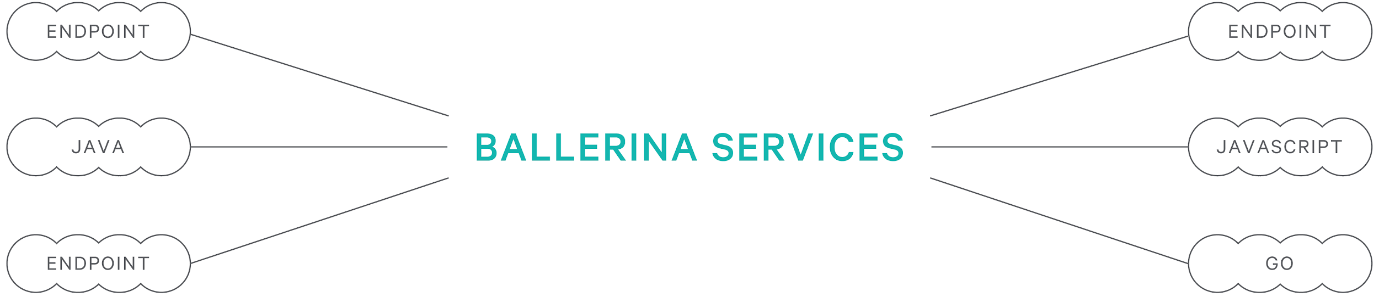
Ballerina is the glue between microservices
Transactions
Circuit Breaking
Protocols
Payloads
Events
Security
Workflow
Streams
Compensation
Notes:
Ballerina Services

Slide 30
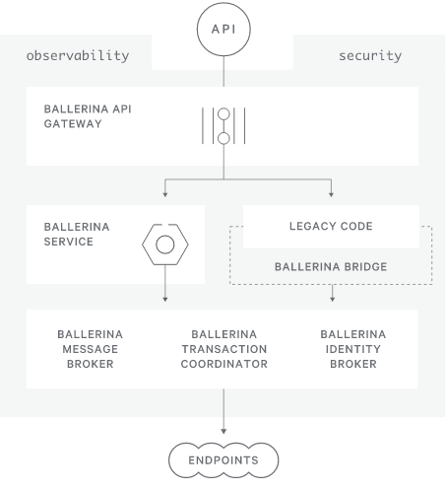
Ecosystem extensions for disaggregated architecture
Kubernetes |  | Jaeger
Docker |  | Prometheus
etcd |  | OAuth2 / OIDC
Istio / Envoy
LinkerD |  | RabbitMQ
Consul |  | AMQP
 |  | Swagger/OpenAPI
MySQL |  | gRPC / Protobuf
Postgres |  | WebSub
Cassandra
 |  | Spring/Java
Visual Studio Code
Intellij IDEA
Notes:
Cloud Runtimes, Configuration Systems, Messaging and Protocols, Service Meshes, Databases, Observability

Slide 31
Ballerina bridges the Integration Gap
Agile |  |  |  | Integration Simple
Edit / Build / Run |  | Package management |  | Services |  | Transformations
Language server |  | Ballerina Central |  | Endpoints |  | JSON primitive
IDE plugins |  | Type safety |  | Resources |  | Annotations
Projects |  | Union types |  | Connectors |  | Circuit breaker
Docker and K8S |  | Flow control |  | -> |  | Async
Debugger |  | Observability |  | Workers, fork/join |  | gRPC
Testerina: unit tests |  | CI/CD |  | Message broker |  | Protobuf
Doc generation |  | Table, vector, map |  | Versioning |  | XML type
CLI extensions |  | Struct |  | Bridge |  | Streams
Dev tracing |  | Lambda |  | Swagger |  | CSV
I/O |  | Tasks, scheduling |  | Databases |  | Session mgmt
Projects |  | Dependency mgmt
In the demo
Discover at
ballerina.io

Slide 32
How to get involved
Learn more
http://ballerina.io
Open source
http://github.com/ballerina-platform/
Get support
Stack Overflow #ballerina tag

